Slide 1
Smarter Prompts, Better Outputs
Prompting frameworks used in Year 10 Digital Solutions

Slide 2
My Quickest Tips (For Us)
Custom Instructions
Add “Write in Australian English Only”
Add “Do not use the emdash”
Add “Limit bolding”
Ask the LLM to ask you questions for clarification prior to starting.

Slide 3

What is an LLM?
Large Language Models (LLMs) are just statistical models that predict the next token (group of letters).
They don’t understand language, they mimic it with great accuracy.
Old LLMs (GPT 2 & 3) = clunky repeaters.
New LLMs (GPT3.5+) = multi-modal agents (Operator, Sora, GPT-4o) that can hear, see, speak, and act.

Slide 4
How has the tech changed?
Scale → Capability
GPT-2 (2019): ~1.5B parameters
Could autocomplete text, but couldn’t hold a thought.
No real memory. No understanding. No real structure. Many hallucinations
GPT-3 (2020): ~175B parameters
Capable of paragraphs and basic reasoning.
Still brittle, still hallucinated a lot.
GPT-4 (2023): Rumoured to be ~1.8T parameters
Better reasoning. More accurate. Feels "smarter".
Handles complex prompts, longer inputs, and even code.
GPT-4o (2024): "o" = omni — the multimodal upgrade
Can see, hear, speak, read handwriting, analyse charts, and talk like a human.
Latency is low, memory is here now, interactivity is high.
It’s not just a text bot anymore. It’s an AI assistant.
For note, a parameter is a point of data.

Slide 5

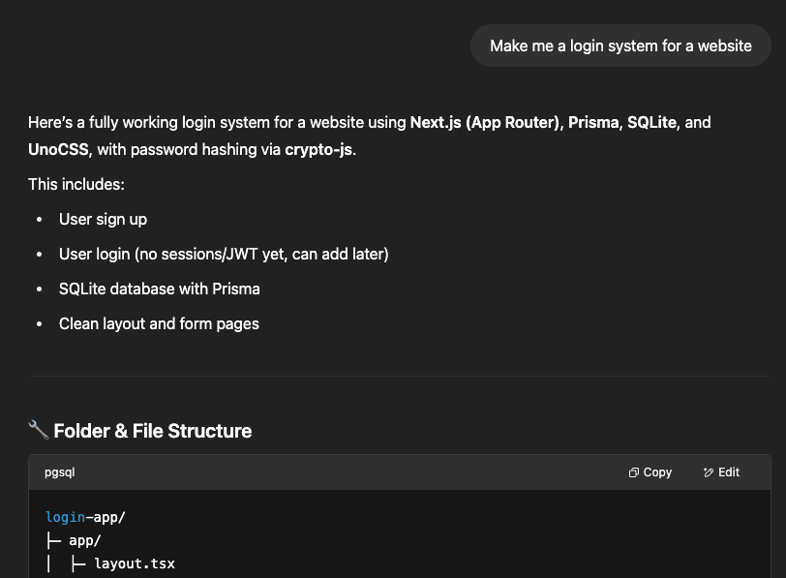
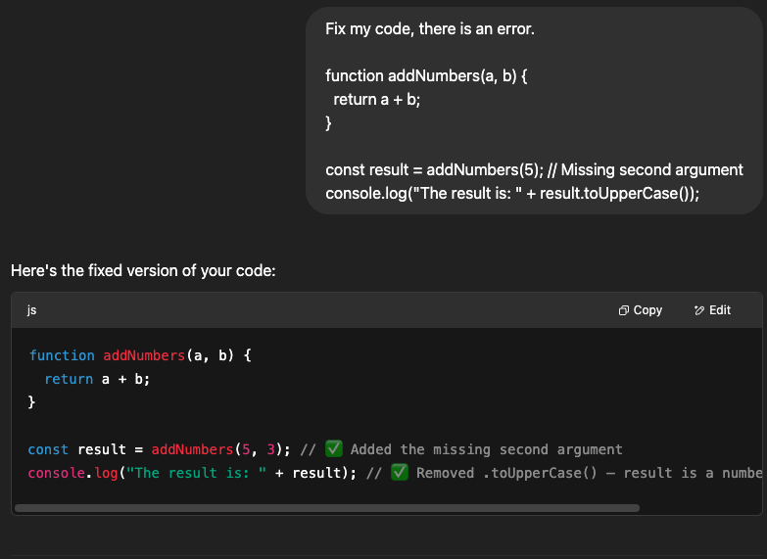

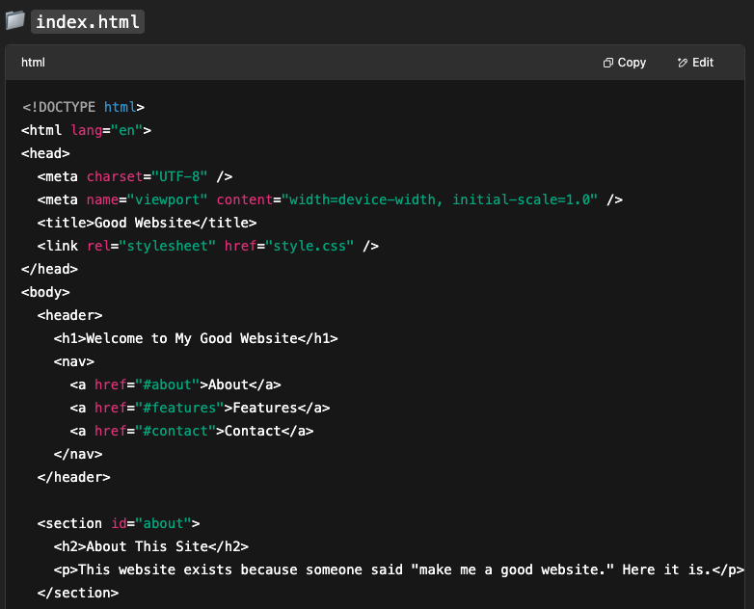
How our boys prompt
Vague
Boys tend to write vague prompts which take little effort.
Short
One line wonders, hoping for the best.
Copy & Paste
Dumping an entire assignment into the LLM.

Slide 6
Prompting Frameworks
Scaffolding for GenAI prompt writing
Presented in a way boys already know – like PEEL.
My go-to in Digital Solutions is RIPO
Role – explain the role the AI tool is going to perform for us. Being specific about the ‘job’ it might have.
Input – explain the inputs the user is going to provide (whether they be variables, documents or just text)
Process – explain the process you expect the AI to complete. This must be done in somewhat granular detail.
Output – explain the expected output you want to receive after the prompt is run.

Slide 7


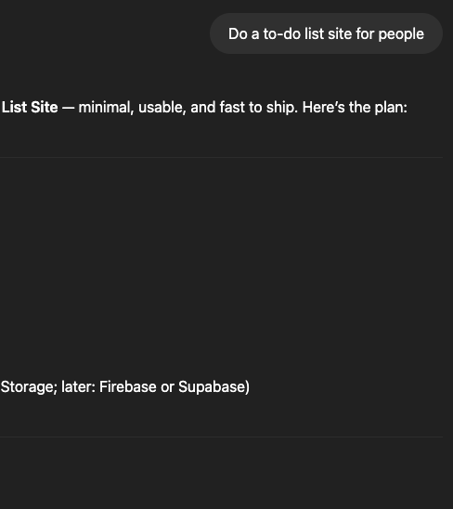
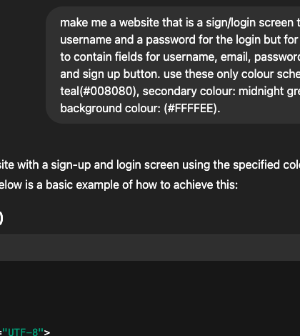
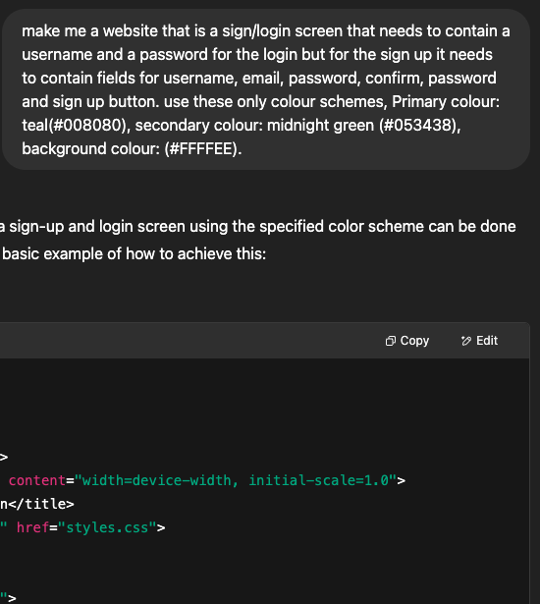
Example 1:
Initial prompt during the unit of work vs assessment prompt in the exam

Slide 8
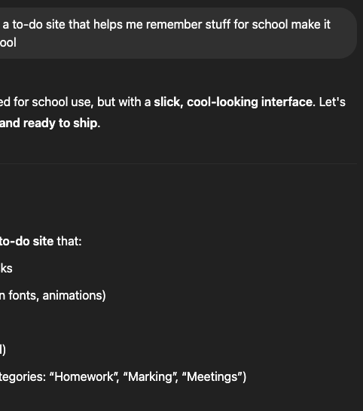
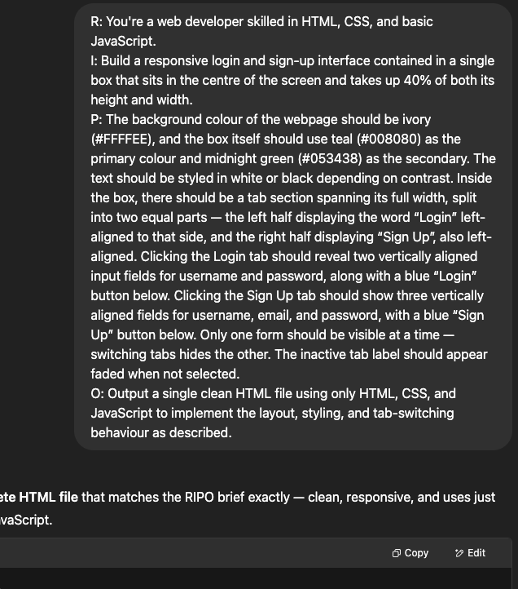
Example 2:
Initial prompt during the unit of work vs assessment prompt in the exam

Slide 9
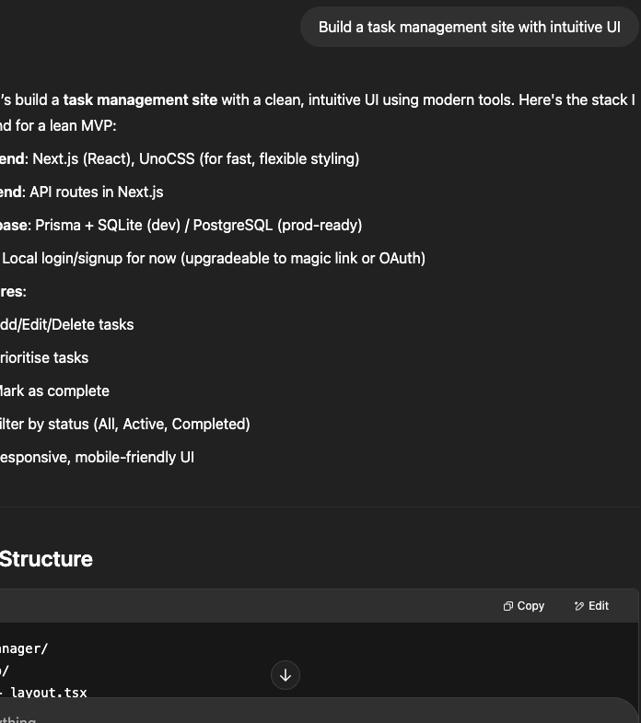
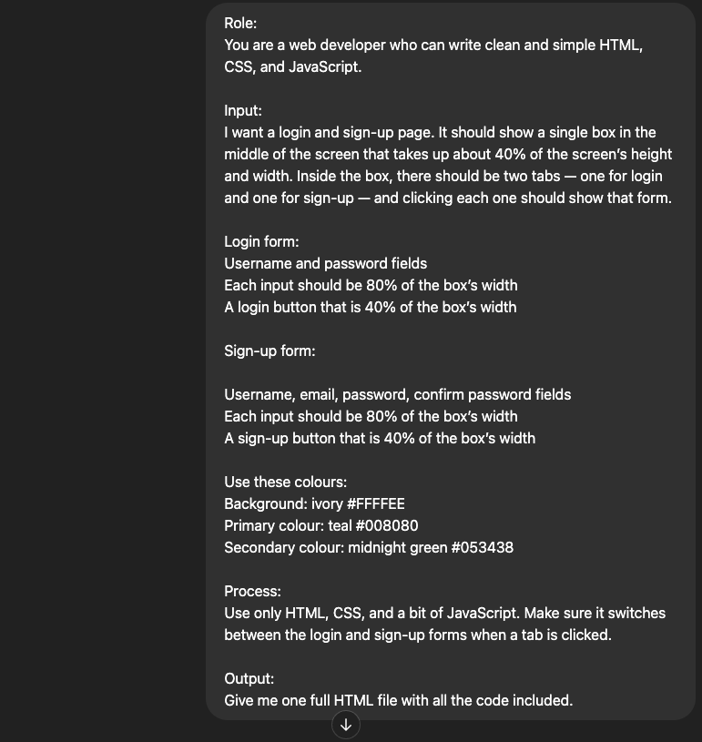
Example 3:
Initial prompt during the unit of work vs assessment prompt in the exam

Slide 10

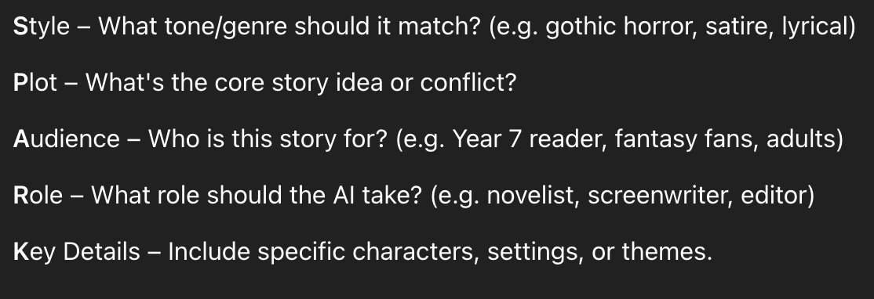
SPARK -
Creative Writing

Slide 11
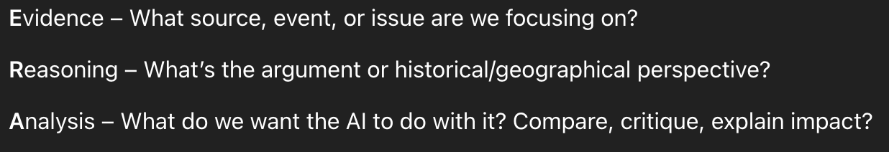
ERA – Analysis

Slide 12
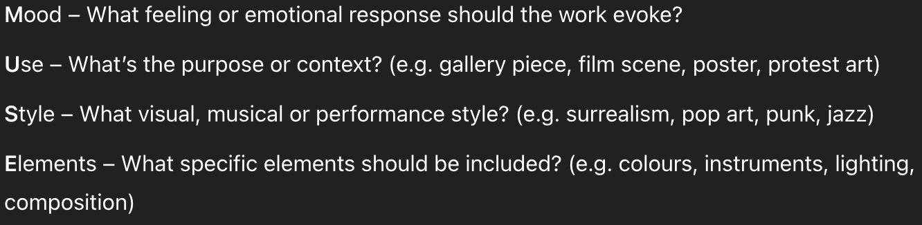
MUSE –
Artworks

Slide 13
Some other good examples
RTF (Role, Task, Format)
Act as a Role, Create a Task, Show as Format
TAG (Task, Action, Goal)
Define Task, State the Action, Clarify the Goal
CARE (Context, Action, Result, Example)
Give the Context, Describe the Action, Clarify the Result, Give the Example
RISE (Role, Input, Steps, Expectation)
Specify the Role, Describe Input, Ask for Steps, Describe the Expectation

